Slide 1
Lecture
Secure Web Communication
and
Web Server Performance
Copyright © Ellis Horowitz 1999-2016

Slide 2
3 Diverse Topics for Today
Secure web communication
  Public Key Cryptography
    Public and private key encryption
  Digital Certificates and Certifying Authorities
  Secure Sockets Layer Protocol (SSL) and https
Web Server Performance
  Popular platforms
  Web Server Farms
  Load Balancing
    Switches
    DNS redirection
Web Server as Proxy Server
  Caching
  Using Apache as a proxy server
Copyright © Ellis Horowitz 1999-2016

Slide 3
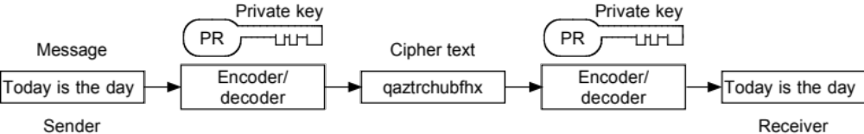
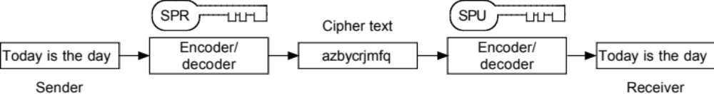
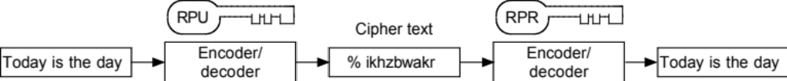
Public vs. Private key Cryptography
Private Key Encryption: sender/receiver share private key
Public Key Encryption: for authentication
Receiver has private and public keys: for privacy
RPR = receiver private key SPR = sender private key
RPU = receiver public key SPU = sender public key
Copyright © Ellis Horowitz 1999-2016

Slide 4
RSA Public Key Encryption
RSA is one of the first practical public-key cryptosystems and is widely used for secure data transmission
A user of RSA creates two large prime numbers and then publishes one of them as his public key
  the numbers are typically 1024 digits or more
  there are a few more steps involved
The most popular algorithm for public key encryption is the RSA algorithm (Rivest, Shamir Adleman)
Determining the private key from the public key involves factoring very large numbers
  but there is no efficient algorithm for factoring large numbers
Though current wisdom is that 1024 bit keys are unbreakable Certificate Authorities use 2048 bit keys
Copyright © Ellis Horowitz 1999-2016

Slide 5
Cryptographic Hash Functions
A hash function or hash algorithm is a function that maps a domain of values into a range of numbers.
Given a data item X (X could be a word or a file), H is called a cryptographic hash function if it is computationally infeasible to find another data item Y, not equal to X, such that the hash value H(X) is equal to the hash value H(Y).
  H(X) is called the message digest or digital signature of X under the hashing algorithm H.
Two well known cryptographic hash functions are MD5 and SHA
Copyright © Ellis Horowitz 1999-2016

Slide 6
Bulk Cipher Methods
public/private key encryption methods are not suitable for general purposes, e.g.
  the RSA method can only encrypt blocks of data which are 11 bytes less than the key size; and each decryption involves complex mathematical calculations
therefore, secure communication on the web uses a combination of public key encryption and conventional one way ciphers
a bulk cipher is one in which the same keys are used to encrypt and decrypt the data; they are fast and can encrypt files of any size
some sample bulk ciphers: RC2, RC4-40, RC4-56, DES40-CBC
Copyright © Ellis Horowitz 1999-2016

Slide 7
Making Sure a Message Has Not Been Altered
A message digest is the number produced by applying a cryptographic hash function to a message
  The message digest is included along with the message; here are the steps that are followed:
Sender produces a message digest using a known hashing algorithm
Message digest is encrypted and sent with the message
Receiver decrypts the digest and then computes the message digest from the actual message to make sure they are identical
For greater security, the message can also be encrypted
Systems combining public key cryptography and message digests are called digital signatures
Copyright © Ellis Horowitz 1999-2016

Slide 8
Certificate Authority
Encryption of data does not solve the entire problem; how do we guarantee that the organizations that we are dealing with are legitimate?
A certificate authority (CA) is an organization that both parties involved in a secure communication, trust
the role of the CA is to verify the identity of an entity (client/server)
once the CA verifies the entity, it issues a digitally signed electronic certificate
  it is signed with the CA’s private key
Web browsers are usually pre-configured with a list of CAs that are trusted
  in IE select Tools, Internet Options,Content Tab, Certificates, Trusted Root Certification Authorities
  In FF select Tools, Options, Advanced, Certificates, View Certificates
Copyright © Ellis Horowitz 1999-2016

Slide 9
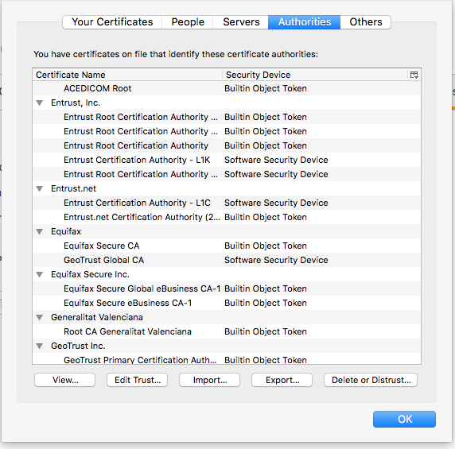
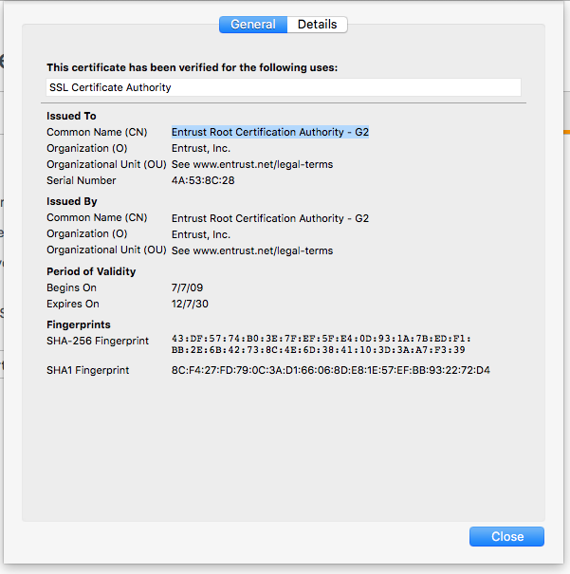
Digital Signatures
A certificate authority dispenses public and private keys
authorities,
including
AOL, Verisign
Actual
certificate
SHA-1 and
MD5
finger
prints
Select Firefox | Open Menu| Preferences | Advanced | Certificates | View Certificates | Authorities | View…
Copyright © Ellis Horowitz 1999-2016

Slide 10
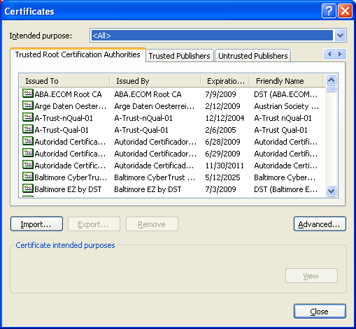
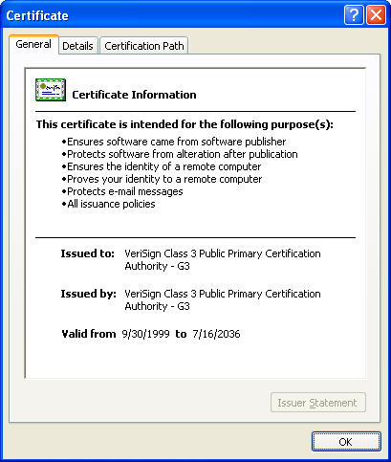
Trusted Root CAs (IE)
In IE 10 select Tools | Internet options | Content | Certificates | Trusted Root Certification Authorities | View
Copyright © Ellis Horowitz 1999-2016

Slide 11
Introduction to SSL
Given public key encryption, cryptographic hashing, message digests and digital certificates, how are these put together to produce secure electronic commerce?
The answer: SSL, is a protocol for establishing an encrypted link between server and client, that uses authentication and encryption of transactional data
Netscape was the original designer of SSL
SSL is occasionally called TLS, Transport Layer Security protocol
SSL is transparent to users, except for the https (rather than http) that appears
the SSL protocol fits between the TCP layer and the HTTP layer
  therefore, SSL can be used to encrypt other application level protocols such as FTP and NNTP
SSL is supported by all major browsers
Copyright © Ellis Horowitz 1999-2016

Slide 12
Introduction to SSL
Secure Sockets Layer (SSL) provides end-to-end security between client and server
authentication of both parties is done using digital certificates
privacy is maintained using encryption
message integrity is accomplished using message digests
SSL for HTTP is referred to as HTTPS and operates on port 443
Copyright © Ellis Horowitz 1999-2016

Slide 13
SSL Graphical View
html pages
Browser
IIS Server
CGI scripts
Windows sockets API
Winsock
Winsock
IIS is Microsoft’s
web server.
Winsock, stands for
Windows Sockets
API, specifies how
Windows network
software interfaces
with TCP/IP.
SSL Key Exchange
SSL
SSL
TCP session
TCP/IP
TCP/IP
physical communication link
line driver
line driver
Copyright © Ellis Horowitz 1999-2016

Slide 14
How SSL Works – Detailed Steps
Client contacts a secure server using https and asks that the server identify itself
Server sends client its digital certificate including the server's public key, thereby verifying that the server is who he says he is
Client checks the certificate root against its list of trusted CAs and that the certificate is unexpired; if all is OK, client generates a session key, encrypts it with server’s public key and sends the cipher back to the server
Server decrypts the symmetric session key using its private key and sends back an acknowledgement and a secure channel is established
Client and server now exchange data that is always encrypted
Before each data transfer, a message digest calculated from the data is sent on the secure channel
Receiving party uses the message digest to guarantee the data has not been modified
Copyright © Ellis Horowitz 1999-2016

Slide 15
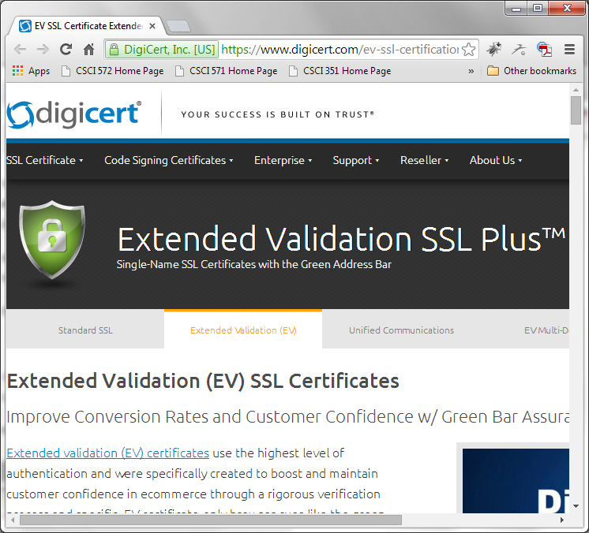
digicert.com
A vendor that offers Extended validation (EV) certificates
Validated companies are guaranteed to use encryption for all password/credit card transactions
digicert activates a green address bar whenever an SSL session is established with a merchant's or issuing bank's EV-validated site
Participating companies include: Facebook, GitHub, etc.
https://www.digicert.com/ev-ssl-certification.htm
Copyright © Ellis Horowitz 1999-2016

Slide 16
References
SSL Protocol Version 3.0 Specification:
  http://www.mozilla.org/projects/security/pki/nss/ssl/draft302.txt
TLS Protocol Version 1.0 Specification:
  http://www.ietf.org/rfc/rfc2246.txt
Extensions to TLS:
  Kerberos: http://www.ietf.org/rfc/rfc2712.txt
  TLS with HTTP/1.1: http://www.ietf.org/rfc/rfc2817.txt
  HTTP over TLS: http://www.ietf.org/rfc/rfc2818.txt
  AES Ciphersuites for TLS: http://www.ietf.org/rfc/rfc3268.txt
Copyright © Ellis Horowitz 1999-2016

Slide 17
Analyzing Web Server Performance
Copyright © Ellis Horowitz 1999-2016

Slide 18
Selecting a Web Platform
Capacity – what capacity is needed from the server, databases, applications
Cost/investment – what are the initial costs and the continuing costs?
Maintenance – who will perform it; how complex
Security – a strategy is needed
Development support – are there staff to support application development
Copyright © Ellis Horowitz 1999-2016

Slide 19
Popular Platforms
Microsoft
  Windows Server 2012 or 2016, Microsoft Nano Server
  Internet Information Services (IIS) version 8 or 10
  MS SQL Server
  Active Server Pages or ASP.NET applications
  Develop with VB, COM, C++, C#, or HTML/CSS/JS
  PHP Manager for IIS 7
Linux
  Ubuntu / Red Hat / SuSe or any other distribution
  Apache web server
  Oracle mySQL
  HTML preprocessor (PHP)
  Java servlets & JSP (Tomcat)
UNIX
  Oracle Solaris 11
  Oracle WebLogic 12c
  IBM WebSphere
  Java Servlets & JSP (Tomcat)
Copyright © Ellis Horowitz 1999-2016

Slide 20
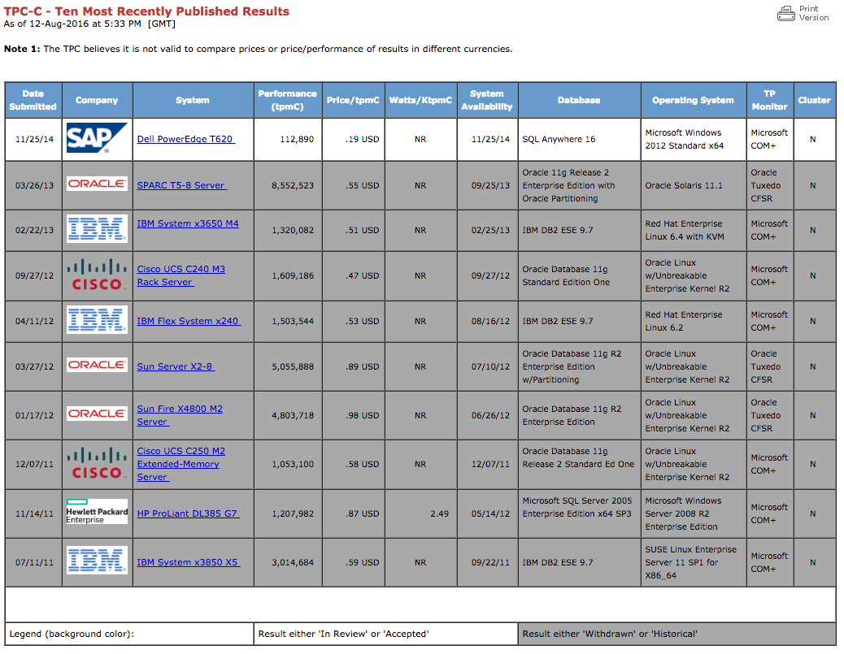
Some Typical Transaction Processing Performance Results
Comparing IBM’s DB2 vs. Oracle 11g vs. SQL Anywhere
Comparison columns www.tpc.org, as of 8/12/2016
Copyright © Ellis Horowitz 1999-2016

Slide 21
Estimating Server Performance Requirements
What is the time required to deliver a request to the server?
  is client authenticated or anonymous, the former is much more costly
  how much data does the client send
  the bandwidth of the slowest link between client and server can determine the time
What is the time required to obtain the result?
  is the result a static HTML page
    is it in the cache, how big is the file
  is the result a dynamic page: is the application that creates it a CGI script, an .NET program, etc.
What is the time to deliver the result?
  the amount of data sent by the server
  bandwidth of the client-server link
  number of simultaneous requests
Copyright © Ellis Horowitz 1999-2016

Slide 22
Estimating Server Performance Requirements
to estimate what performance is needed, estimate
  the number of clients that will connect each second, connections per sec
  the number of bytes the client will send to the server during each transaction
  the number of bytes the server will send to the client during each transaction, bytes transferred
  how much of the link the web server is allowed to use
multiply the number of clients connecting each second by the total number of bytes transferred during each connection and divide the result by the percentage of the link the web server is allowed to use
E.g. 120 clients connect twice each minute implies 240 connections per minute or 4 per second. If each client sends 1Kbyte of data and receives 15Kbytes back, then the server needs to support 64Kbytes per second or 512 Kbitsps or roughly .5megabits per second.
General rule: the link should have at least twice the bandwidth as the average above
Copyright © Ellis Horowitz 1999-2016

Slide 23
Web Server Farms
A web server farm consists of multiple server machines and load balancing hardware that distributes web requests across the servers
  this provides incremental scalability and high availability at a low cost.
  For example, a farm of four independent servers, each with 95 percent availability has an overall availability of 99.999 percent.
Generally, Web servers have a relatively small amount of static data, and an application server (behind the firewall) provides dynamic content from information stored in a database or exiting applications
However, if storage is shared across all servers, then there is a single point of failure
  mirroring is one possible solution using a DBMS feature to push new data to all servers
Copyright © Ellis Horowitz 1999-2016

Slide 24
One Possible Web Farm Architecture
Web servers
Application
servers
Internet
Load
Balancing
Switch
Firewall
dbms
in this scheme the
DBMS is a single point
of failure
Copyright © Ellis Horowitz 1999-2016

Slide 25
Web Server Farms vs. Single Large Machines
Single Server Server Cluster
Number of servers 1 x Sun E20K (*) 8xDell PowerEdge T630(**)
Processor: UltraSPARC IV+ Xeon E5
Speed: 1.8GHz 2.2 GHZ
Processors: 36 8x6 (48 total)
Memory: 144 GB 500 GB (each)
Cost (per machine): $2,134,547 8 x $1,529
Cost (total): $2,134,547 $12,232 (was $87K in ’08)
conclusion: obvious
(*) This product reached EOL. No longer available. Superseded by Oracle SPARC Servers. See
https://www.oracle.com/servers/sparc/index.html
(**) See
http://www.dell.com/us/business/p/poweredge-t630/pd
Copyright © Ellis Horowitz 1999-2016

Slide 26
Why Load Balancing is Needed
In the scheme below
  a pool of server machines appear as a single host and client requests are routed alternately to each one
  However, in the event of a failure, the load balancer can detect the failure and route the request elsewhere
  Persistent data must be fully replicated; all nodes are identical
Internet
Load balancer
Round Robin DNS
pool of
servers
Copyright © Ellis Horowitz 1999-2016

Slide 27
Example Load Balancing Switch
Load balancing hardware exists to prevent requests going to servers that have failed; e.g.
  Cisco Content Switching Module, Cisco Catalyst 6500; RADware appDirector
continually monitors servers for application availability and database connectivity
routes traffic only to available applications and ensures that traffic is not directed to a failed server or application.
can perform an HTTP redirect to a different location upon failure of a real or virtual IP address.
Supports Cookie, HTTP redirect, and Secure Sockets Layer (SSL) session ID persistence features guaranteeing that a specific client gets the correct content, regardless of Internet mega-proxies and shopping-cart application design.
Copyright © Ellis Horowitz 1999-2016

Slide 28
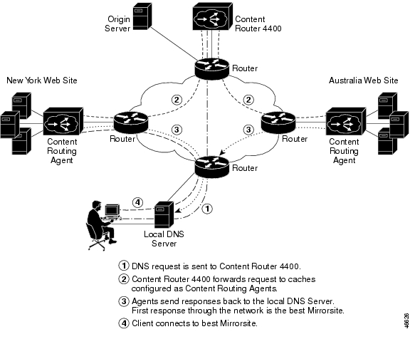
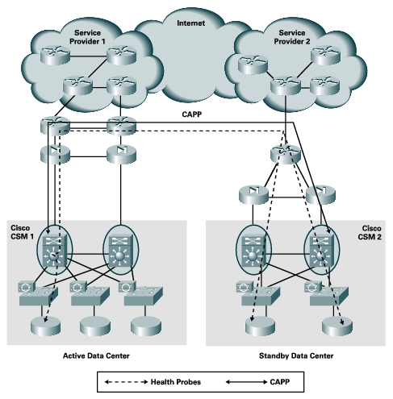
Two Scenarios for Using Cisco Content Router Load Balancing Switch
Supporting multiple sites around the world
Supporting standby data center
Copyright © Ellis Horowitz 1999-2016

Slide 29
Another Approach to Load Balancing:
DNS Redirection
A browser begins by resolving a host/domain name into an IP address
A DNS resolver may be on the browser machine, on the client network, or a remote DNS server
DNS resolvers can be configured to return one of a set of IP addresses, e.g.
$ nslookup google.com
Server: 12.127.17.71
Address: 12.127.17.71#53
Non-authoritative answer:
Name: google.com
Address: 173.194.68.139
Name: google.com
Address: 173.194.68.101
Name: google.com
Address: 173.194.68.113
Name: google.com
Address: 173.194.68.100
Name: google.com
Address: 173.194.68.138
Name: google.com
Address: 173.194.68.102
Copyright © Ellis Horowitz 1999-2016

Slide 30
DNS Redirection
2.request IP addr
from root server
Root
DNS
Server
Local
DNS
Server
3.send IP addr
of authoritative server
1.request IP addr
4.request IP address
Authoritative
DNS
Server
Monitoring
google.com
AT&T Services
12.127.17.71
5.return 173.194.68.139
client
6.send HTTP request
to 173.194.68.139
…
google.com
173.194.68.139
google.com
173.194.68.101
google.com
173.194.68.113
Copyright © Ellis Horowitz 1999-2016

Slide 31
DNS Redirection
This form of load balancing has problems because
  web browsers will cache the IP address for a given domain
  some operating systems cache IP addresses for given domains
However, some DNS servers use algorithms other than round robin, e.g.
  load-balancing: they check the load on many web servers and send the request to the least loaded
  proximity-routing: they send the request to the nearest server, when the servers are geographically distributed
  fault-masking: check for down web servers and avoid them
Copyright © Ellis Horowitz 1999-2016

Slide 32
The Google Compute Engine
Web server farms are quickly being overtaken by cloud computing services
Cloud computing is the delivery of computing as a service rather than a product
  shared resources, software, and information are provided to computers and other devices as a utility (like the electricity grid) over a network (typically the Internet)
Google Compute Engine is one such service that provides virtual machines that run on Google infrastructure.
See https://developers.google.com/compute/docs/, especially the 4 minute video
This semester you will be using Amazon's Elastic Compute Service (AWS) or Google Cloud Platform
Copyright © Ellis Horowitz 1999-2016

Slide 33
Web Server Performance Testing
Copyright © Ellis Horowitz 1999-2016

Slide 34
Web Server Benchmarking
Web server benchmarking is the process of estimating a web server performance in order to find if the server can serve sufficiently high workload.
The performance is usually measured in terms of:
  Number of requests that can be served per second (depending on the type of request, etc.);
  Latency response time in milliseconds for each new connection or request;
  Throughput in bytes per second (depending on file size, cached or not cached content, available network bandwidth, etc.).
The measurements must be performed under a varying load of clients and requests per client.
Copyright © Ellis Horowitz 1999-2016

Slide 35
Other Web Servers: Lighttpd, nginx
lighttpd (pronounced "lighty") [www.lighttpd.net] is an open-source web server optimized for speed-critical environments
  The low memory footprint, small CPU load and speed optimizations make lighttpd suitable for servers that are suffering load problems, or for serving static media separately from dynamic content.
  lighttpd is free software/open source, and is distributed under the BSD license
  Lighttpd is used by a number of high-traffic websites
Nginx (pronounced “Engine-X”) [nginx.org] is an open source Web server and a reverse proxy server for HTTP, SMTP, POP3 and IMAP protocols, with a strong focus on high concurrency, performance and low memory usage. It is licensed under a BSD-like license
  Nginx uses an asynchronous event-driven approach to handling requests, instead of the Apache HTTP Server model that defaults to a threaded or process-oriented approach. Nginx's event-driven approach can provide more predictable performance under high loads
  According to Netcraft's August 2014 Web Server Survey, Nginx was found to be the third most widely used web server across all domains and the second most widely used web server for all "active" sites
Copyright © Ellis Horowitz 1999-2016

Slide 36
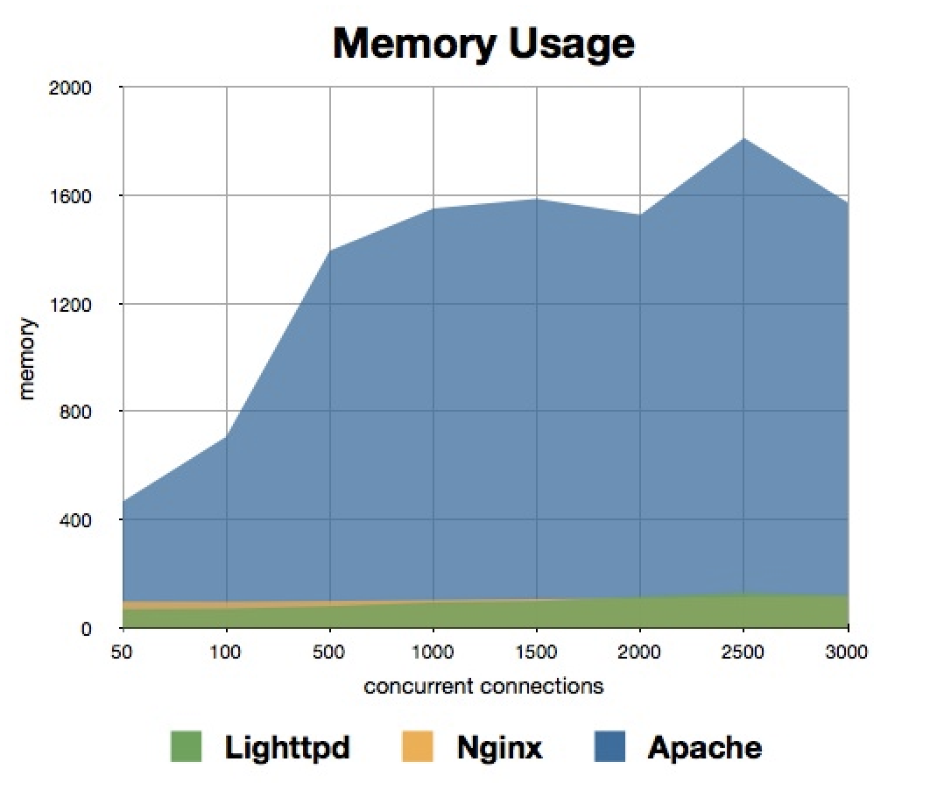
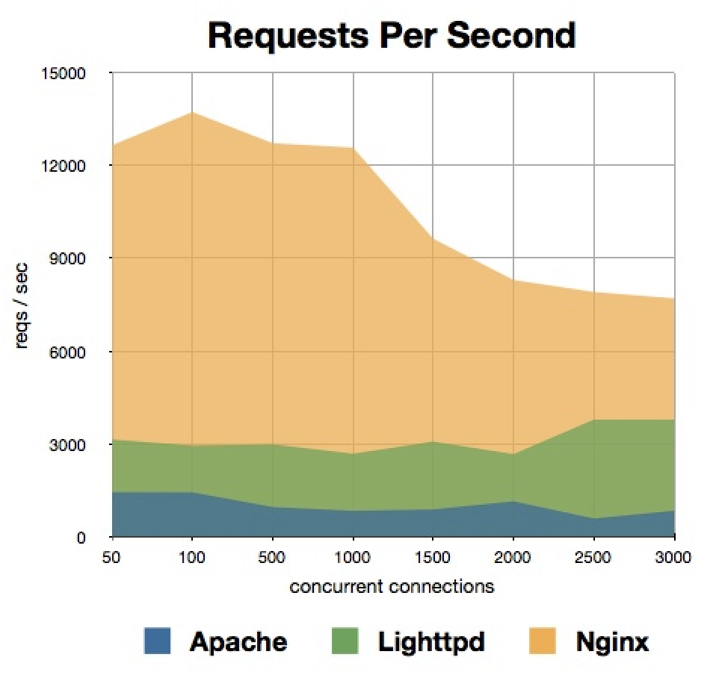
Comparisons of Lightppd, Nginx, Apache
Memory Usage and Requests Per Second
http://wiki.dreamhost.com/Web_Server_Performance_Comparison
Copyright © Ellis Horowitz 1999-2016

Slide 37
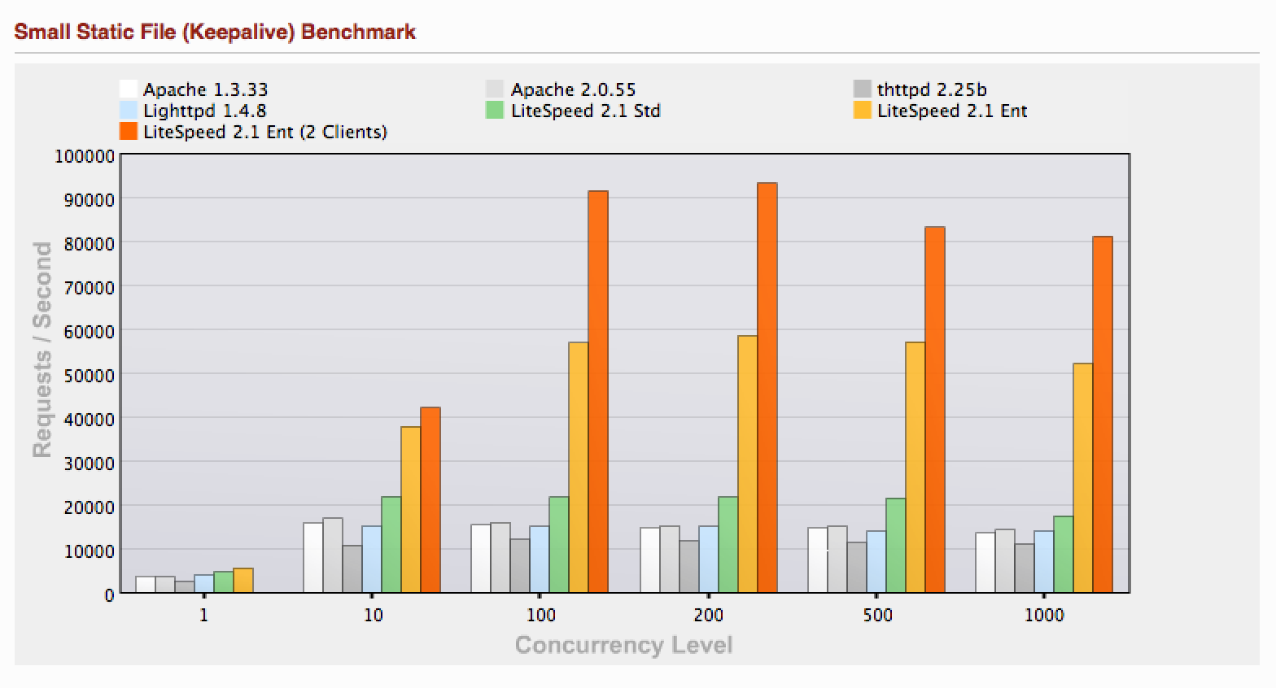
More Comparisons of Lightppd and Apache
Requests Per Second
Each test case was run three times with the best result used. A small static file with 100 bytes was used
The ab apache benchmark program was used to gather the data (see the next set of slides). LiteSpeed is a commercial version of lighttpd ( see https://www.litespeedtech.com)
Copyright © Ellis Horowitz 1999-2016

Slide 38
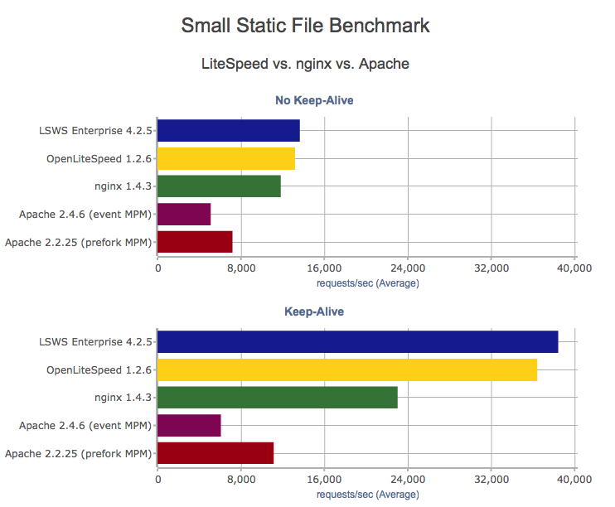
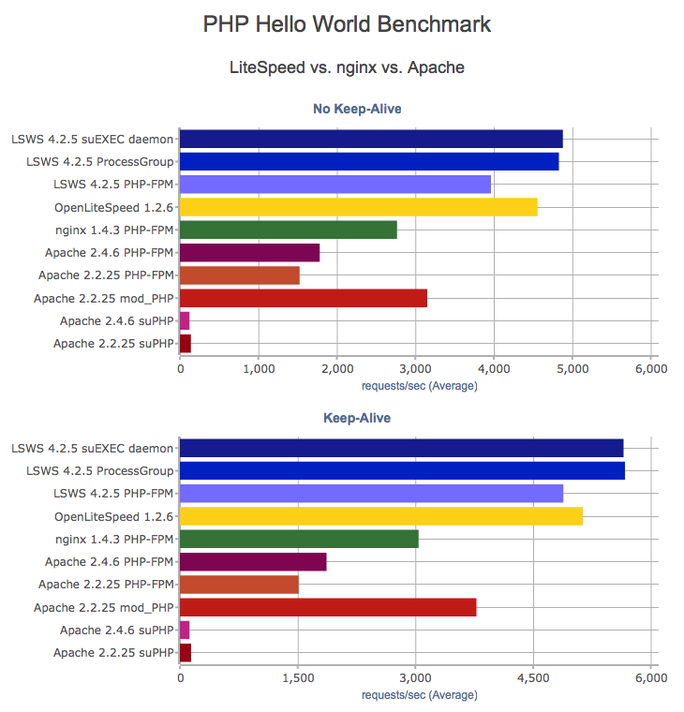
LiteSpeed vs. nginx vs. Apache
http://www.litespeedtech.com/products/litespeed-web-server/benchmarks/small-static-file
Copyright © Ellis Horowitz 1999-2016

Slide 39
Apache Benchmarking
ab is a tool for benchmarking your Apache Hypertext Transfer Protocol (HTTP) server.
It is included in your apache installation; in the bin directory
Among other things, it shows how many requests per second your Apache installation is capable of serving.
It is a command line program; its description can be found at
http://httpd.apache.org/docs/2.2/programs/ab.html
Copyright © Ellis Horowitz 1999-2016

Slide 40
Exercise to run ab
1. Note down the server load using the uptime command
  cs-server.usc.edu(16): uptime
  9:21am up 609 day(s), 21:29, 2 users, load average: 28.68, 30.12, 29.96
Create a static (small) html page as follows, snkpage.html, and place it in the document root
<!DOCTYPE HTML PUBLIC "-//W3C//DTD HTML 4.0 Transitional//EN">
<html> <head> <title>Webserver test</title> </head>
<body> This is a webserver test page. </body> </html>
3. Connect to the bin directory and run ab
cs-server.usc.edu(1): ./ab -n 1000 -c 5 http://cs-server.usc.edu:7890/snkpage.html
This sends 1000 requests to the server with currency (c = 5) number of multiple requests at a time
4. To save the output for 50,000 requests in a comma separated file
$ ab -k -n 50000 -c 2 -e apache2r1.cvs http://cs-server.usc.edu:7890/snkpage.html
Copyright © Ellis Horowitz 1999-2016

Slide 41
Sample Output of ab
This is ApacheBench, Version 2.3 <$Revision: 655654 $>
Copyright 1996 Adam Twiss, Zeus Technology Ltd, http://www.zeustech.net/
Licensed to The Apache Software Foundation, http://www.apache.org/
Benchmarking cs-server.usc.edu (be patient)
Completed 100 requests
Completed 200 requests
Completed 300 requests
Completed 400 requests
Completed 500 requests
Completed 600 requests
Completed 700 requests
Completed 800 requests
Completed 900 requests
Completed 1000 requests
Finished 1000 requests
Server Software: Apache/2.2.22
Server Hostname: cs-server.usc.edu
Server Port: 7890
Document Path: /snkpage.html
Document Length: 168 bytes
Concurrency Level: 5
Time taken for tests: 0.746 seconds
Complete requests: 1000
Failed requests: 0
Write errors: 0
Total transferred: 430000 bytes
HTML transferred: 168000 bytes
Requests per second: 1341.04 [#/sec] (mean)
Time per request: 3.728 [ms] (mean)
Time per request: 0.746 [ms] (mean, across all concurrent requests)
Transfer rate: 563.13 [Kbytes/sec] received
Connection Times (ms)
min mean[+/-sd] median max
Connect: 0 0 0.6 0 10
Processing: 1 3 1.9 3 26
Waiting: 1 3 1.9 3 25
Total: 2 4 2.0 3 26
Percentage of the requests served within a certain time (ms)
50% 3
66% 3
75% 4
80% 4
90% 4
95% 5
98% 7
99% 12
100% 26 (longest request)
Copyright © Ellis Horowitz 1999-2016

Slide 42
Improving Apache Web Server Performance (1)
Additional RAM, faster CPU always helps!
Load only the required modules; this reduces the memory footprint
The HostnameLookups directive enables DNS lookup so that hostnames are logged instead of the IP address, which adds latency to every request;
  If hostnames are desired, use the Apache utility logresolve (which ships with Apache) to resolve IP addresses of an entire log file before analyzing the log file; e.g.
  logresolve < access.log > access.log.resolved
If AllowOverride is not set to None, then Apache will attempt to open .htaccess file in each directory that it visits; enable .htaccess for only those directories that contain it
Do not set MaxClients too low as that will cause requests to be queued and possibly lost; do not set MaxClients too high as that will cause the server to start swapping and response time will degrade;
  Let MaxClients = (Total RAM dedicated to Web Server)/Max child process size
Tune MinSpareServers and MaxSpareServers so that Apache need not spawn more than 4 child processes per second; when this happens an error is placed in the error_log file
HTTP compression can be enabled using mod_gzip or mod_deflate; the payload is compressed only if the browser requests it
Copyright © Ellis Horowitz 1999-2016

Slide 43
Improving Apache Web Server Performance (2)
Use two versions of apache, one “tiny version” to serve static content and forward requests for dynamic content to the “larger version”; request forwarding is done by using mod_proxy and rewrite_module; here is an example:
Suppose there is a lightweight Apache server listening to port 80 and the heavyweight Apache server listening on port 8088. Then the following configuration in the lightweight Apache can be used to forward all request except request for images to the heavyweight server.
ProxyPassReverse / http://%{HTTP_HOST}:8088/
RewriteEngine on
RewriteCond %{REQUEST_URI} !.*\.(gif|png|jpg)$
RewriteRule ^/(.*) http://%{HTTP_HOST}:8088/$1 [P]
Copyright © Ellis Horowitz 1999-2016

Slide 44
Improving Apache Web Server Performance (3)
mod_fastcgi is a general FastCGI module, which uses FastCGI rather than normal CGI to connect to the CGI scripts.
  With normal CGI, the webserver communicates with the CGI script through environment variables, and the client browser with the CGI script through its standard input.
  With FastCGI, each script acts as a daemon, being started once and handling multiple requests. Instead of environment variables, the server passes all information about the request through standard input, allowing FastCGI scripts to even be executed on different servers, over extra TCP connections.
  See www.fastcgi.com
Use “direct modules”: mod_perl, mod_php, mod_python, etc
For several scripting languages (including Perl, Python, PHP, Tcl and Ruby) there are separate interpreter modules that give the language more control over Apache, as well as a performance boost.
In general this is done by using specific knowledge about the language, and by keeping the language's Interpreter or Virtual Machine hanging around, passing it scripts as they get invoked. This avoids the execution overhead, and in some languages the compiling phase.
Copyright © Ellis Horowitz 1999-2016

Slide 45
Topic 3: Web Server as a Proxy Server
Definition of Proxy Server: An intermediary server that accepts requests from clients and either forwards them or services the request from its own cache
Implications
  A proxy server is a web server
  a proxy server acts as a server to the client that makes a request, and it acts as a client to the servers it connects to
  A proxy server can monitor all documents provided by server responses
  A proxy server can monitor all client requests to other servers
Copyright © Ellis Horowitz 1999-2016

Slide 46
HTTP Protocol and Proxy Servers
The protocol between client and proxy server, or between proxy servers is HTTP, even if the request is for ftp, telnet, mailto, etc.
e.g. an ftp request is sent as an HTTP request to a proxy server as:
GET ftp://ftp.usc.edu/pub/softeng.txt HTTP/1.0
User-agent: Mozilla/4.0
Accept: */*
only the last proxy server has to speak the ftp protocol to the ftp server, in this case ftp.usc.edu
Copyright © Ellis Horowitz 1999-2016

Slide 47
Proxy Servers and FTP
The ftp:// is included in the HTTP request
Either the URL includes the username/password
http://<username>:<password>@host/<url-path>
or if omitted, username=anonymous and password = the email address of the client or mozilla, etc. this is user settable
If the url has a name but no password, e.g.
ftp://smith@ftp.usc.edu/pub/soft.txt
then the proxy server generates
401 Unauthorized
which causes a prompt for the password to appear
Copyright © Ellis Horowitz 1999-2016

Slide 48
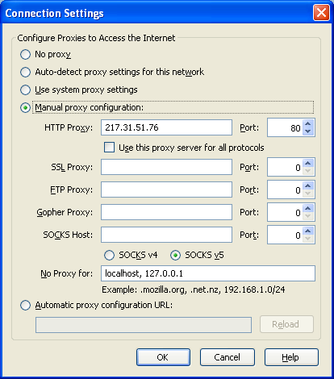
Pointing to a Proxy in Your Browser
To configure your browser to point to a proxy server
  In IE click on Tools | Internet Options | Connections | LAN Settings | click on Proxy Server checkbox. Click on Advanced.
  In Firefox click on Tools | Options | Advanced | Network | Settings
  In Chrome click on Menu | Settings | Show Advanced Settings | Change proxy settings | LAN settings | Proxies (Web Proxy)
Copyright © Ellis Horowitz 1999-2016

Slide 49
Why Use a Proxy Server
to prevent access to restricted sites
  e.g. in a library
to control access to a restricted site
  the proxy server can request name/password
to enhance security by controlling which application level protocols are permitted
to improve performance by maintaining a cache
to modify content before delivery to the client, e.g. reducing image sizes for display on TV sets, or creating summaries for display on pagers
to act as an anonymizer, removing identifying information from HTTP messages (see proxy list at http://samair.ru/proxy/)
Copyright © Ellis Horowitz 1999-2016

Slide 50
Example of Anonymizing Proxy
Client issues:
GET /something/file.html HTTP/1.0
Date:Sun, 01 Oct 2000 23:25:17 GMT
User-agent: Mozilla/4.75 (Win98; U)
From: joe@hardware.com
Referer: http://www.irs.gov/tax-audits.html
Cookie: profile="football,lite beer"
Cookie: income-bracket="30K-45K"
The anonymized message is
GET /something/file.html HTTP/1.0
Date:Sun, 01 Oct 2000 23:25:17 GMT
User-agent: Mozilla/4.75 (Win98; U)
Copyright © Ellis Horowitz 1999-2016

Slide 51
Caching and Revalidation
Every Web object changes over time, so each Web object has a useful life, or "freshness."
  Caches must determine whether or not their copy of an object is still "fresh," or whether they need to retrieve a new copy from the origin server.
Caching and revalidation refer to the process of storing copies of documents retrieved by the proxy server to local storage (disk) or memory so it is readily available
Caching improves performance, reduces latency, and saves network bandwidth
Potential disadvantage is the risk of receiving stale data
HTTP/1.1 added the concept of conditional GET
  retrieve a document based upon whether it has been modified since the last access
  an up-to-date check that returns “304 not modified” means the cache copy can be used
  successful revalidations are faster than cache misses and nearly identical to cache misses
Copyright © Ellis Horowitz 1999-2016

Slide 52
Revalidations
clients
Caches
Origin web server
cache hit
browser
Proxy
server
cache
miss
Proxy
server
browser
Cache plus
revalidation hit
freshness
check
browser
Proxy
server
304 Not Modified or 200 OK
Copyright © Ellis Horowitz 1999-2016

Slide 53
Validation
Validation is used by servers and caches to communicate when an object has changed.
  caches avoid having to download the entire object when they already have a copy locally, but they're not sure if it's still fresh.
The most common validator is the Last-Modified time.
If a validator is not present, and there isn't any freshness information (Expires or Cache-Control) available, most caches will not store an object at all.
HTTP 1.1 introduced a new kind of validator called the ETag.
  ETags are unique identifiers that are generated by the server and changed every time the object does.
Almost all caches use Last-Modified times and E-Tags in determining if an object is fresh.
Most modern Web servers will generate both ETag and Last-Modified validators for static content automatically
Copyright © Ellis Horowitz 1999-2016

Slide 54
Browsers and Proxies Use the last_modified Date
Retrieve a document if it has been modified since the last access, E.g. a response:
HTTP/1.0 200 OK
Server: Apache 1.3.20
Date: Wed, 30 Dec 2008 09:23:43 GMT
Last-modified: Tue, 29 Dec 2008 10:11:12 GMT
Content-type: text/html
Content-length: 3456
a conditional Get uses the timestamp from Last-modified header and sends it along in a If-Modified-Since:
GET /htdocs/myfile.html HTTP/1.0
User-agent: Mozilla/4.7
Accept: text/html, image/*
If-modified-since: Tue, 29 Dec 2008 10:11:12 GMT
Copyright © Ellis Horowitz 1999-2016

Slide 55
Web Server's Respond to Conditional GET Requests
if the document is unchanged, server responds
HTTP/1.0 304 Not Modified
Server: Apache 1.3.1
Date: Thu, 31 Dec 2008 14:15:22 GMT
if the document has changed the server responds
HTTP/1.0 200 OK
Server: Apache 1.3.1
Date: Thu, 31 Dec 2008 14:15:22 GMT
Copyright © Ellis Horowitz 1999-2016

Slide 56
How Web Caches Work
If the object's headers tell the cache not to keep the object, it won't
If the object is authenticated or secure, it won't be cached.
A cached object is considered fresh (that is, able to be sent to a client without checking with the origin server) if:
  It has an expiry time or other age-controlling directive set, and is still within the fresh period.
  If a browser cache has already seen the object, and has been set to check once a session.
  If a proxy cache has seen the object recently, and it was modified relatively long ago.
Fresh documents are served directly from the cache, without checking with the origin server.
If an object is stale, the origin server will be asked to validate the object, or tell the cache whether the copy that it has is still good.
Copyright © Ellis Horowitz 1999-2016

Slide 57
Proxies Need to Know When to Download a Fresh Version of a Page
The cache must determine the freshness of each object
As just shown, a cache can pass a "get-if-modified" request to the server each time an object is requested.
  When a cache receives a request for an object that it has already stored, it sends a "get-if- modified" request. If the cache's modification date for that object is older that the server's, the cache retrieves a new copy of the object.
Use freshness data (such as the time expiration data on the object's header under HTTP 1.1) to evaluate a stored object, and then retrieve a fresh copy of an object when its freshness expires.
Apply heuristics to judge the life expectancy of each object based on the elapsed time since the object was last modified.
Copyright © Ellis Horowitz 1999-2016

Slide 58
Freshness Heuristics
When the proxy retrieves an object from the server, the cache notes the Last Modified date on the object, and then assumes that the object has an additional useful life that is a fixed percentage (10%, for example) of the time already elapsed since the last modification.
  For example, if an object was last modified 10 days before the cache fetches it, the cache assumes that the object will grow stale in one more day, and the cache itself satisfies requests for that object for that day.
  When the freshness period elapses, the cache will return to the server to revalidate the object's freshness and obtain a new copy if the object has changed.
Heuristics sometimes results in stale files being sent from the cache, because the 10% additional freshness allowance sometimes proves to be too generous. On the other hand, heuristics can also result in unnecessary traffic between the cache and the server when the cache sends "get-if- modified" requests that prove unnecessary.
Copyright © Ellis Horowitz 1999-2016

Slide 59
Cache GET Request Flowchart
request
arrives
cached?
no
no (200)
fetch from
server
yes
revalidate with
server
Fresh?
no
fresh
enough?
yes (304)
update
freshness
of document
store into
cache
yes
serve to
client
Copyright © Ellis Horowitz 1999-2016

Slide 60
Guaranteeing Freshness
Using conditional GET for all requests guarantees that stale data is never returned, but is very wasteful as most requests will return “not modified”
thus servers use heuristics
  the age of the document at the time of last retrieval; if a document is fairly old, its unlikely to change soon; e.g. image files
  dynamic pages, e.g. weather reports, usually include
  Expires: 0
  Expires: now
  Expires: Thu, 01 Jan 1970 00:00:00 GMT
  Expires: current time
Copyright © Ellis Horowitz 1999-2016

Slide 61
Cache Control Response Header
Pragma: no-cache, does not work in most browsers,
deprecated in favor of cache-control command
cache-control = public, responses from this server may be stored without restriction
cache-control = "max-age=43,200" the document should be considered stale after 43,200 seconds
cache-control = "must revalidate" means the caching service must revalidate the document after it becomes stale from the originating server, or report an error. It must not pass on the stale version
cache-control = "no-cache" means responses can be cached, but the cached copy may not be reused for subsequent requests without revalidating the cached copy with the originating server
cache-control = "no store" means this response may not be cached on nonvolatile storage
Copyright © Ellis Horowitz 1999-2016

Slide 62
HTML Meta Tags vs. HTTP Headers
HTML authors can put tags in a document's <HEAD> section that describe its attributes. These Meta tags are often used in the belief that they can mark a document as uncacheable, or expire it at a certain time.
<META http-equiv="Expires" content="Tue, 20 Aug 2005 14:25:27 GMT">
<META HTTP-EQUIV="Pragma" CONTENT="no-cache">
<META HTTP-EQUIV="Refresh" CONTENT="3;URL=http://www.some.org/some.html">
<META HTTP-EQUIV="Set-Cookie" CONTENT="cookievalue=xxx;expires=Friday, 30-Dec-05 23:59:59 GMT; path=/">
Meta tags are easy to use, but aren't very effective. They are never honored by proxy caches and they are honored by browser caches only together with HTTP Headers.
For a more detailed explanation see
http://www.htmlgoodies.com/beyond/reference/article.php/3472881
Copyright © Ellis Horowitz 1999-2016

Slide 63
HTTP Headers
HTTP headers give you a lot of control over how both browser caches and proxies handle your objects.
  They can't be seen in the HTML, and are usually automatically generated by the Web server. However, you can control them to some degree, depending on the server you use.
HTTP headers are sent by the server in front of the HTML, and only seen by the browser and any intermediate caches.
A typical HTTP 1.1 response headers might look like this:
HTTP/1.1 200 OK
Date: Fri, 30 Oct 1998 13:19:41 GMT
Server: Apache/1.3.3 (Unix)
Cache-Control: max-age=3600, must-revalidate
Expires: Fri, 30 Oct 1998 14:19:41 GMT
Last-Modified: Mon, 29 Jun 1998 02:28:12 GMT
ETag: "3e86-410-3596fbbc"
Content-Length: 1040
Content-Type: text/html
Copyright © Ellis Horowitz 1999-2016

Slide 64
HTTP Headers
Set up is done using directives of the specific server
In Apache 1.3 the module mod_expires lists the directives that can be use to set this up:
  http://httpd.apache.org/docs/1.3/mod/mod_expires.html
  Directives can be located in the httpd.conf file or in .htaccess files in specific subdirectories
  the server will satisfy directory requests with the cache controls ETag and LastModified, if IndexOptions includes the TrackModified directive.
With IIS, directives are part of ASP code:
  http://support.microsoft.com/default.aspx?scid=kb;en-us;234067
    <% Response.CacheControl = "no-cache" %>
    <% Response.AddHeader "Pragma", "no-cache" %>
    <% Response.Expires = -1 %>
Copyright © Ellis Horowitz 1999-2016

Slide 65
Using the Apache Web Server as a Proxy
the Apache web server can be used as a proxy server if certain settings are established
when acting as a proxy server, Apache must manage its cache
  it must decide when and which pages to remove when the cache is full
Copyright © Ellis Horowitz 1999-2016

Slide 66
Apache Configuration Settings for Proxy Server
User webuser
Group webgroup
ServerName www.myco.com
AccessConfig /dev/null (nul in Win32)
ResourceConfig /dev/null
Port 8000 we can change ports later
ProxyRequests on
CacheRoot /usr/www/site.proxy/cache a special directory
CacheSize 5 (size of cache in kilobytes)
CacheGcInterval 4 (#hrs between garbage collection)
CacheMaxExpire 24 (#hrs to retain docs)
CacheLastModifiedFactor 0.1
CacheDefaultExpire 1
NoCache a-domain.com another-domain.edu
Copyright © Ellis Horowitz 1999-2016

Slide 67
Apache Cache Settings
CacheSize sets the size of the cache area in kilobytes
CacheGcInterval specifies how often in hours Apache checks the cache and does a garbage collection if the amount of data exceeds CacheSize
CacheMaxExpire specifies how long in hours cached documents are retained
CacheLastModifiedFactor estimate expiry date using the formula expiry-period = time-since-last-modification * factor
CacheDefaultExpire if the document is fetched via a protocol that does not support expiry times, then use the specified number of hours as the expiry time
NoCache specifies a list of hosts/domains from which documents are not cached
Copyright © Ellis Horowitz 1999-2016

Slide 68
Garbage Collection
Compiled programming languages, C/Pascal, require the user to maintain storage using calls such as malloc() and free()
Interpreted languages like Lisp and Java do automatic garbage collection, periodically scanning memory for chunks no longer required
In proxy servers, garbage collection manages the cache space
the challenges are:
  determine which files are not likely to be needed in the future
  determine which files are most likely to be needed in the future
Copyright © Ellis Horowitz 1999-2016

Slide 69
LRU Algorithm
Least recently used; for web pages if a page was recently accessed it is likely to be accessed again
Weighted LRU
  number of recent accesses
  retrieval transfer time
  remaining freshness time
  weighting by transfer time
  positive weighting by size
Copyright © Ellis Horowitz 1999-2016

